Slide 1

Year 12 Information Evening
Welcome
October 2026

Slide 2
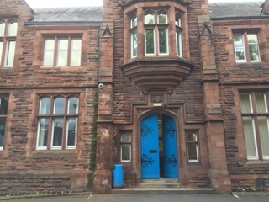
Year 12
Welcome!

Slide 3
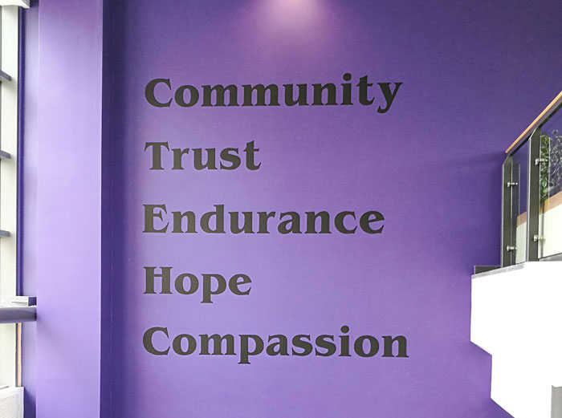
Welcome
Our School Aims:
Standards, Responsibility & Opportunities.........for all
Our Christian Values:

Slide 4
Contact us:
Phone: 01228 516051 ext 263
Email: 6form@trinity.cumbria.sch.uk

Slide 5
Contacting Sixth Form
AWI – Mr Winter
TME – Mrs Medley | DKI – Mr Kinsella
JRO – Mrs Robinson | ARI – Mrs Richardson
JLI – Mrs Little
CLD – Mrs Ledingham
JSO – Ms Southwell
NCR – Mrs Cricket
JGR – Mrs Groves
HCO – Mrs Cook
RLY – Mrs Lyons
KBR – Mr Brown
SNO – Mr Norman
CKH - Khawam

Slide 6
School day - timings
Timings
08:35 – 08:55 | Form Time
08:55 – 09:55 | P1
09:55 – 10:55 | p2
10:55 – 11:10 | Break
11:10 – 12:10 | p3
12:10 – 13:10 | p4
13:10 – 13:40 | Yr 12 Lunch
13:40 – 14:40 | p5
14:40 – 15:05 | Form time

Slide 7
‘SIMS intouch’ – school emails
Student timetables and examination timetables
Newsletters, trip information, club timetable, etc
Important messages such as snow closures
Information about parents evenings and other important events.
Lesson absence etc

Slide 8
Year 12 Key info
Blanks on timetable = some free lessons and some private study
EPQ, Sports Leader, Cyber EPQ and Core Maths in addition to 3 subject lessons
Resit GCSE Eng and Maths
Extra-Curricular – D of E etc

Slide 9
Guidelines for Success
Life as a Year 12 student

Slide 10
6th From Expectations
What do we expect from students in all subjects?
Non-Negotiables
Coats off
Phone switched off and in bag.
Arrive on time
Homework completed
Have correct equipment – folder, calculator etc
Pleasant, co-operative and try hard
100% attendance ideally, minimum 95%

Slide 11
Attendance
N marks are unauthorised absences (which really should never happen). Absences should be covered by a phonecall, an email or a note to the Sixth Form office. The N marks are the amended with the correct code, such as medical.
If students have N marks, I will let them know during the week, mainly in person, sometimes by email, and give you a couple of days for parents/carers to provide a reason (to the office). If this has not happened by Friday, they will be placed on FROZEN FREES. This means that for one week all their non contact lessons will be taken in the library. The periods will be added to their timetable and the register for that week.

Slide 12
Absence
Contact the sixth form office before 9:00am on the first day of absence and preferably each day thereafter.
01228 516051 ext 263
95% attendance required
<90% drop ½ grade per subject
<85% drop 1 grade per subject
<80% drop 2 grades per subject

Slide 13
Planned absence
If students know they are going to be off, for example have a medical dental or hospital appointment or a uni open day, they should collect a Leave of Absence Form from outside the office, complete it, get it signed and post it in the box outside the office.

Slide 14
Employment
Paid employment can be a great way to improve a student’s confidence, communications, teamwork and leadership skills.
We advise no more than 8 -10 hours of paid employment per week, and less in the run up to examinations.

Slide 15
Dress –please ask me if you aren’t sure
Reminders
No crop tops
No shorts
Leggings must be work with a long top
Skirts need to be of an appropriate length
Remember you can’t wear coats in class so dress for that please (e.g wear a jumper if it’s cold!)

Slide 16
Supporting Learning in Sixth Form
Mr Winter

Slide 17
Russell Group Skills Audit
Ability to work independently
Ability to write clear, coherent essays and arguments
Ability to solve problems and think critically
Ability to contribute ideas
Ability to contribute to a team
Ability to manage time well

Slide 18
We expect Sixth Form students to take full responsibility for their learning
This means:
Ensuring that material learned in class is reviewed at home or in private study time
Persisting with work when it is difficult and asking for help/clarification when needed
Meeting homework and coursework deadlines
Become a historian, mathematician, etc

Slide 19

What does success really look like?

Slide 20
How can you help?
Ensure they have a suitable workspace
Monitor the amount of part time work (no more than 8 – 10 hours) – must not be during school hours, 8.30am – 3.30pm
Help with organisation/revision
Maintain home/school contact
Phone 6th form office re: absences

Slide 21
Mistakes parents/carers make
“ they are 17/18 years of age, nothing I can do”
Stop taking an interest in homework, progress, interims etc
Disregard attendance issues
Disregard emails, letters etc
Leave it too late to raise concerns
Cover for students

Slide 22
Exam Boards
www.aqa.org.uk
www.ocr.org.uk
www.qualifications.pearson.com (edexcel)
Please note: Curriculum Leaders have the final decision as to whether students are entered for exams.

Slide 23
Folders and Organisation
Specification
Exam papers
Mark schemes
Examiners reports
Dividers
We check these each term.

Slide 24
Key Dates 2026/27
Trinity Sixth Form

Slide 25
Other useful information
Interim reports
  Interim 1 – December 2026
  Interim 2 – March 2027
  Interim 3 – May 2027
Mock exams week beginning 12th April 2027.
Year 12 Parents Evening will take place on Thursday 13th May 2027
Btec Deadlines – set by individual subjects
Futures Ready Visit – April 2027

Slide 26
Work Experience
5 days between Oct 2026 and July 16th 2027
Work experience must be something students are thinking about doing as a career not more part-time work!
Students arrange, support from careers adviser & 6th form team.

Slide 27
New & Improved facilities 2025/26
Trinity Sixth Form

Slide 28
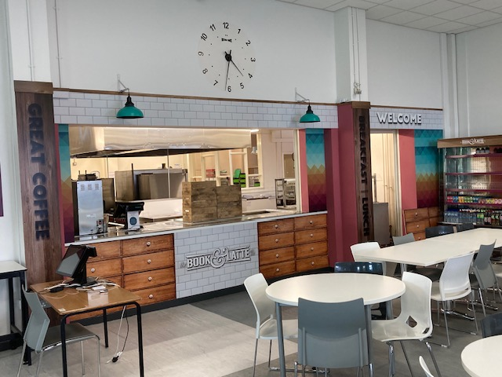
Bistro

Slide 29
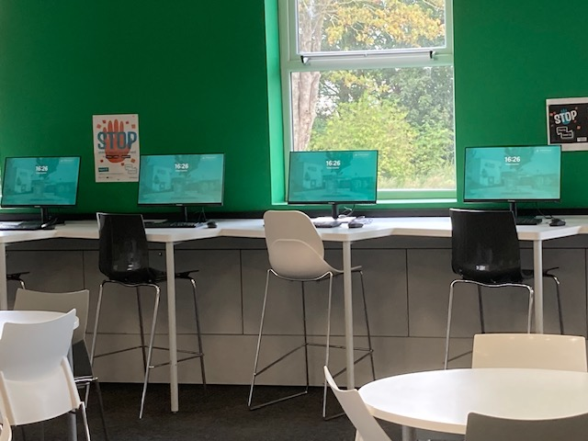
New PC’s in Bistro

Slide 30
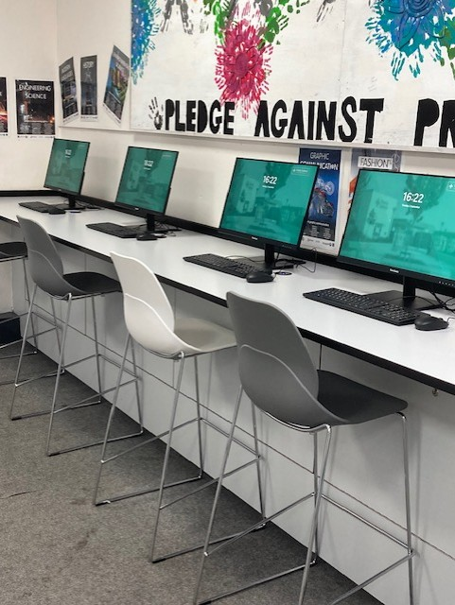
New PC’s in LRA’s

Slide 31
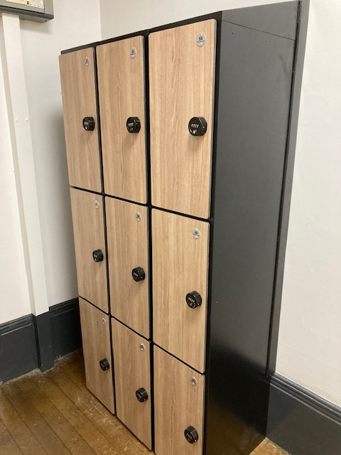
More lockers

Slide 32
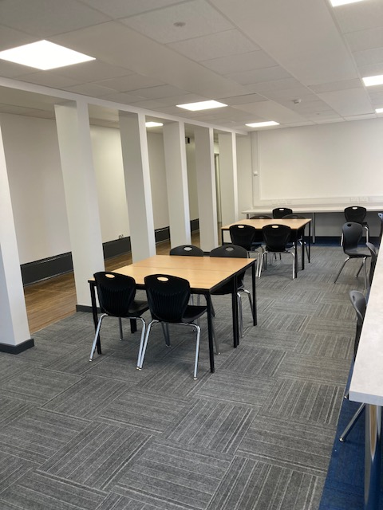
New study hub

Slide 33
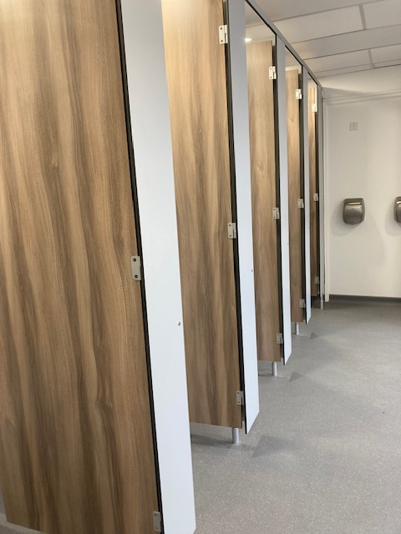
New boys toilets

Slide 34
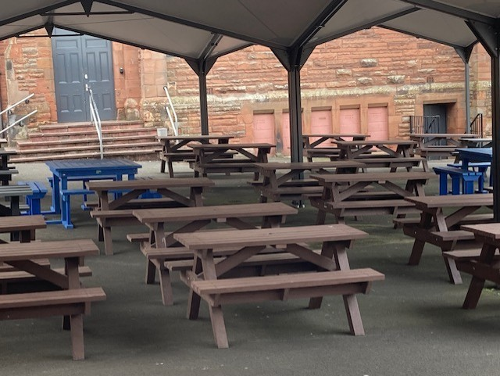
More benches

Slide 35
Come and have a chat!
Any questions please ask!

