Slide 1


Slide 2
Welcome to
Trinity
Year 10

Slide 3
Mr Kay

Slide 4
THE CHALLENGE!
To be the best GCSE year ever at Trinity

Slide 5
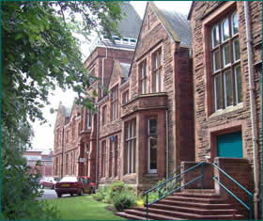
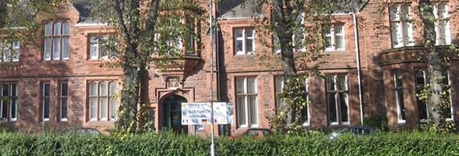
Approach to Learning
"I learned that the only way you are going to get anywhere in life is to work hard at it. Whether you're a musician, a writer, an athlete or a businessman, there is no getting around it. If you do, you'll win; if you don't, you won't."
- Bruce Jenner (Olympic Gold Medalist, Decathlon)

Slide 6
Messages
Last week GCSE results
Look yourself in the face
Improvements every year
Early modules and GCSE
Changes to groupings and courses.
Importance of English and Maths
End of year exams

Slide 7
Achievement
Expected progress not targets
Forecast grade not expected grade

Slide 8
Are you going to be a pupil or a student in year ten?
Pupil
Needs to be told what to do.
Only does what they are told to do
Teacher enforces work rate and behaviour.
Motivation comes from others.
Student
Independent
Responsible
Well motivated
Well organised and prepared.

Slide 9
Approach to Learning
"I learned that the only way you are going to get anywhere in life is to work hard at it. Whether you're a musician, a writer, an athlete or a businessman, there is no getting around it. If you do, you'll win; if you don't, you won't."
- Bruce Jenner (Olympic Gold Medalist, Decathlon)

Slide 10
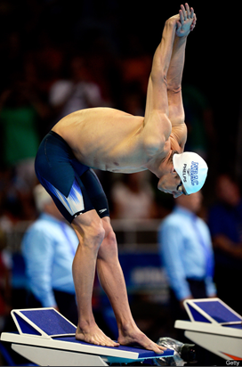

Michael Phelps
Olympic Champion

Slide 11


Slide 12


Slide 13
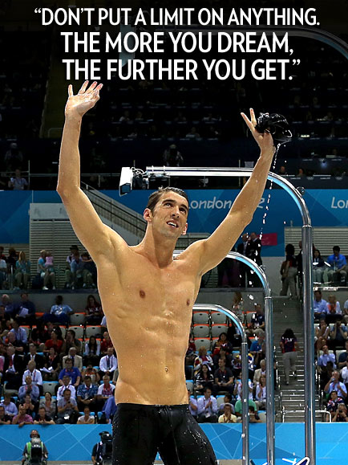

Slide 15
Mr Runciman
Future aspirations

Slide 16
Mr McArdle

Slide 17
The Sixth Form Experience

Slide 18




Year 10
The Year Ahead
The 3 As

Slide 19
Some Key Dates
20th September – Expectation Evening
W/B 1st October – Progression Interviews
8th November – Interim 1 to parents
31st January 2012 – Interim 2 to parents
21st February – Parents’ Evening
15th March – Revision Freeze Day
W/B 13th May – Exam season begins
27th June – Work Ready Day
27th June – Reports to parents
W/B 1st July – Work Experience Week
Controlled Assessments
Science modular exams
Apprenticeship evening

Slide 20
Mr Lythgoe

Slide 21
“The first question is always about climate....”

Slide 22
Teach you
Read, Hide + Re-do
Active

Slide 23
Every year...
Down time
Rewards
Signs

Slide 24
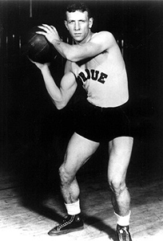
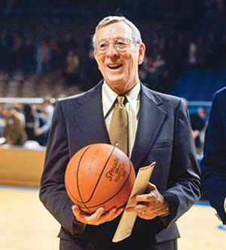
Organisation and Planners
Failure to prepare is preparing to fail.
John Wooden

Slide 25
The world is run by those who show up.

Slide 26
Attendance
Missing just 17 days in one year (90%) can cause a drop of a full grade at GCSE.
Only about one in four students with attendance less than 90% achieve 5 A*-C GCSEs.
Only about one in ten students with less than 80% attendance achieve 5 A*-C GCSEs

Slide 27
Maths and English
Maths
English

Slide 28
Ms Hawkin

Slide 29
Working together
Students
School
Parents/carers

Slide 30
Bill Gates Quotes
“Before you were born, your parents weren’t as boring as they are now. They got that way from paying your bills, cleaning your clothes...”

Slide 31
Bill Gates Quotes
If you think your teacher is tough – get a boss!”

Slide 32
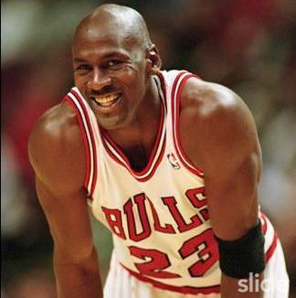
“Some people want it to happen, some wish it would happen, others make it happen ”
Michael Jordan
(Greatest ever basketball
Player)

Slide 33
Mr Kay
“Be here, work hard and behave yourself!”

Slide 34
THANK YOU FOR COMING

